Slide 1
Object Oriented Software Engineering (OOSE)
22CS017
Introduction to Class diagram

Slide 2
Index
Introduction to Class diagram
Class diagram for:
College Information System
Library Management system
Hospital Management System
Online shopping system/Banking System
Practice Questions

Slide 3
Introduction to Class Diagram
1. Class diagram is a static diagram.
2. It represents the static view of an application.
3. Class diagram is not only used for visualizing, describing, and documenting different aspects of a system but also for constructing executable code of the software application.
4. Class diagram describes the attributes and operations of a class and also the constraints imposed on the system.
5. The class diagrams are widely used in the modeling of object-oriented systems because they are the only UML diagrams, which can be mapped directly with object-oriented languages.
6. Class diagram shows a collection of classes, interfaces, associations, collaborations, and constraints. It is also known as a structural diagram.

Slide 4
Purpose of Class Diagram
Analysis and design of the static view of an application.
Describe responsibilities of a system.
Base for component and deployment diagrams.
Forward and reverse engineering.

Slide 5
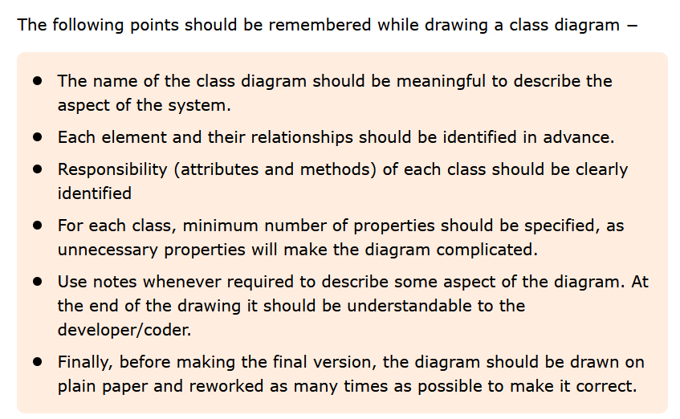
How to Draw a Class Diagram?

Slide 6
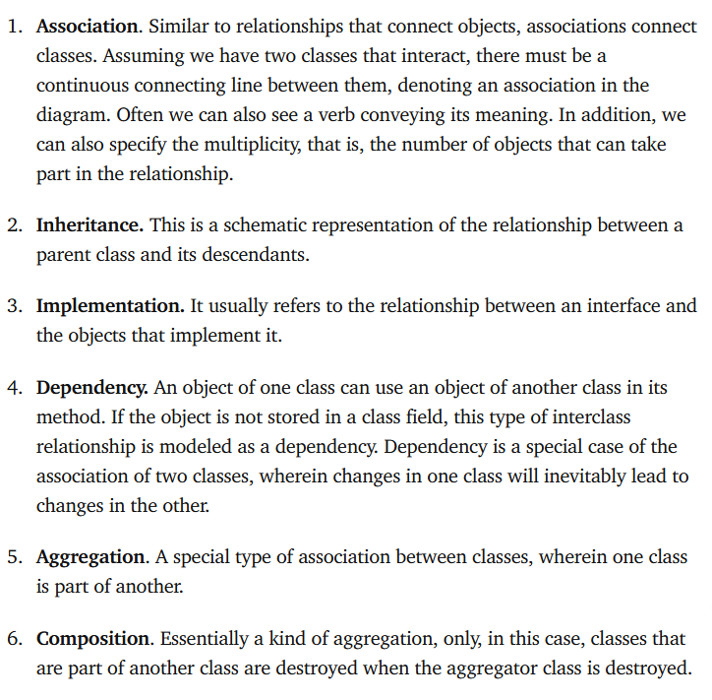
six types of relationships between classes:

Slide 7
College Information System
Class Diagram is the way to represent the relationship between the classes. In this article, we will see about the class diagram for the College Information system.
Classes :
College Information – This class is the overall main class of the whole system.
Department – This class contains the details of various departments in the college.
Student – This class is for students, and it is the base class for two child classes – UGStudent and PGStudent. Since UGStudent is a Student and PGStudent is a Student
UGStudent – This class is the child class of Student and it contains the details of UGStudent.
PGStudent – This class is the child class of Student and it contains the details of PGStudent.

Slide 8
Cont..
Staff – There are two types of staff in the college. So this class is the base class of two child classes – TeachingStaff and NonTeachingStaff.
TeachingStaff – This class is the child class of Staff. Since TeachingStaff is a Staff.
NonTeachingStaff – This class is the child class of Staff. Since NonTeachingStaff is a Staff.
Classroom – This class contains the details of each and every classroom in the whole college.
Canteen – This class is for storing Canteen details inside the college
Library – This class contains the details of a particular library in the college
Bus – This class contains the details of a bus along with the bus driver details
Hostel – Hostel can be of two types. So this class is the base class of two child classes – BoysHostel and GirlsHostel.

Slide 9
BoysHostel – This class is the child class of the Hostel. Since BoysHostel is a Hostel.
GirlsHostel – This class is the child class of the Hostel. Since GirlsHostel is a Hostel.
Parking – This class contains the details of the parking area in a college. The parking area can be used by students, staff, visitors etc.
Auditorium – Auditorium is a place where any events or guest lecture happens. This class contains the details of it.

Slide 10
Attributes :
CollegeInformation – CollegeName, City, ContactNumber
Department – DepartmentId, DepartmentName, HODName, TotalStaffs,TotalStudents
Student – StudentId, StudentName, Gender, Year, ClassId
Staff – StaffId, StaffName, DepartmentId, Salary
Classroom – ClassId, Section, DepartmentId
Canteen – InchargeId, ItemsList, AvailableList
Library – LibraryId, LibrarianName, BookSection, TotalBooks
Bus – BusId, BusNumber, DriverName, Destination, TotalSeats
Hostel – StudentId, BlockNumber, RoomNumber
Parking – SlotId, VehicleNumber, VehicleOwnerName
Auditorium – AuditoriumName, EventsList, Date, Time, TotalSeats, DepartmentId

Slide 11
Methods :
CollegeInformation :
Open() – This method tells whether the college is open or not.
CollegeDetails() – This method contains the college details like name, its location and contact number.
Department :
DepartmentDetails() – This method contains the department name and its corresponding Head of the department name, the total students count of each department.
ShowEvents() – This method is to show any events in a particular department.
Student :
StudentDetails() – This method contains all the information about each and every student in the college.
PayFees() – This method contains the payment status of each student.
IsPresent() – This method shows whether the student is present to the college on a particular date.
Staff :
StaffDetails() – This method contains the details of both teaching as well as non-teaching staff along with their salary details.

Slide 12
Classroom :
ClassroomDetails() – This method shows the details of each classroom and to which department the classroom belongs.
IsOccupied() – This method tells whether the classroom is occupied or not
Canteen :
ShowItems() – This method shows the items which are present in the canteen
Buy() – This method is used to buy any item in the college canteen.
Library :
LibraryDetails() – This method contains the details of the library inside the college
SearchBooks() – This method is used to search any book in the library.
LendBooks() – This method is to get the book from the library.
ReturnBooks() – This method is used to contain the details of the returned book.
PayFine() – This method contains the details to pay the fine.
Bus :
BusDetails() – This method contains the details of buses like area details, bus name and the driver details.
SeatsAvailability() – This method shows the details of available seats in a particular bus.

Slide 13
Hostel :
HostelDetails() – This method contains the details of the hostel like the number of blocks, warden details, food details etc.
CheckIn() – This method is to check whether the student is present at the hostel or not.
CheckOut() – This method is to check whether the student is checked out from the hostel or not when they are in the outstation.
Parking :
ParkVehicle() – This method is used to store the details of vehicles that are parked inside the college.
Auditorium:
BookEvents() – This method is to book the auditorium for conducting the events.

Slide 14
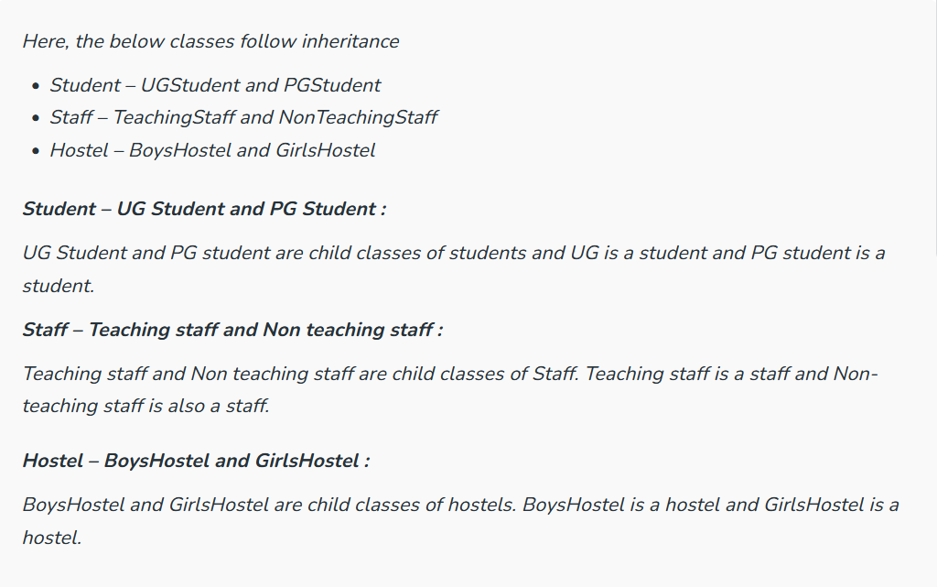
Relationship :
1. Inheritance :
Inheritance is the practice of acquiring the required properties from one class to another class. The class which acquires the properties is known as the child class. The class which allows its properties to be acquired is known as the parent class. It is simply known as the Parent-child relationship. i.e. “Is-a” relationships

Slide 15
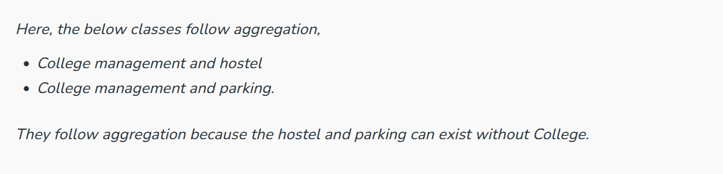
2. Aggregation :
In Aggregation, Class A and Class B are dependent on each other which indicates that A has an instance of B and B has an instance of B, but they are not physically contained inside each other. In simple terms, Class B can exist without Class A. It follows “has-a” relationship.

Slide 16
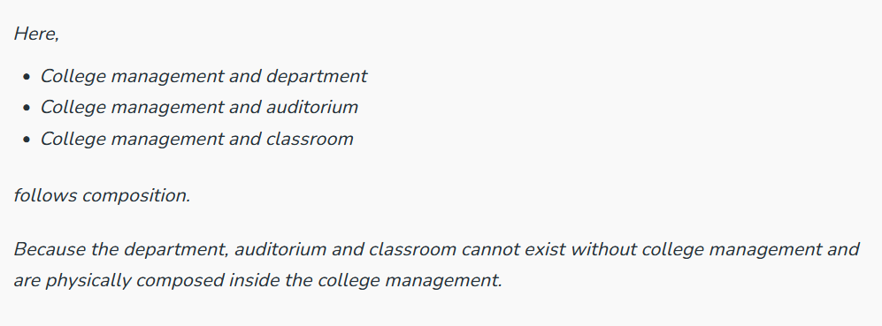
3. Composition :
In composition, Class A and Class B are dependent on each other which indicates that class A has an instance of class B inside class A. In other words, class B is physically contained inside class A. So class B cannot exist without class A. It follows a “has-a” relationship.

Slide 17
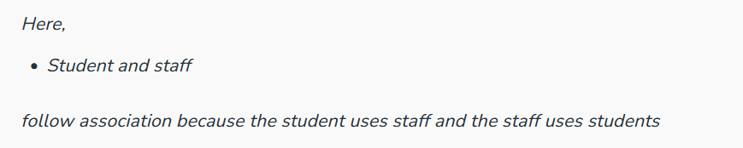
4. Association :
In Association, one class is not committed to the other class in any means, but both of the classes use each other and function in their own respective spaces. It follows the “using” relation.

Slide 18
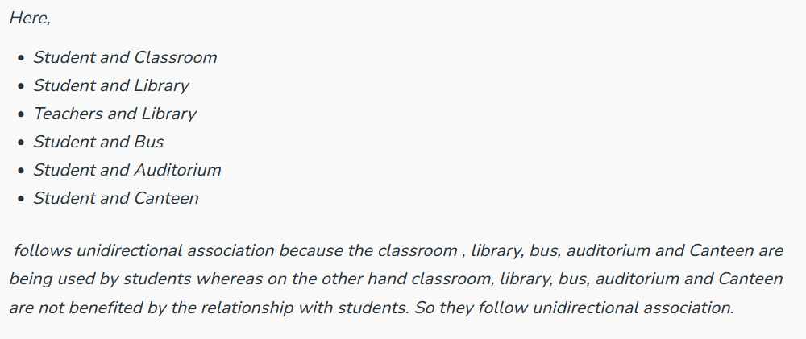
5. Unidirectional Association :
In unidirectional Association, two classes are related in some ways, but only one class makes use of the other class whereas the other class is not benefited from the relationship. Class A can call Class B whereas Class B cannot call Class A.

Slide 19
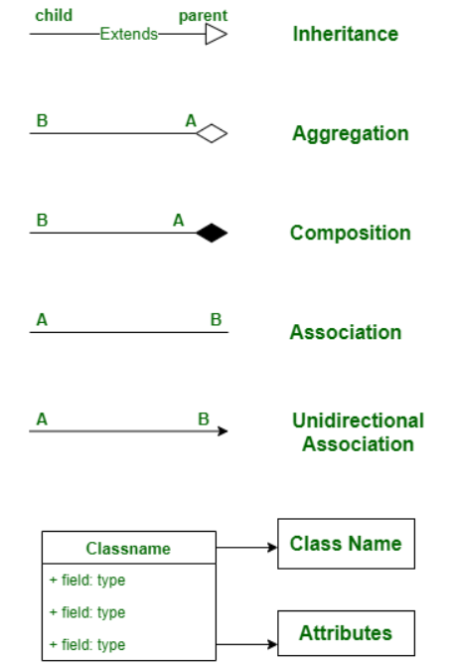
Notations

Slide 20
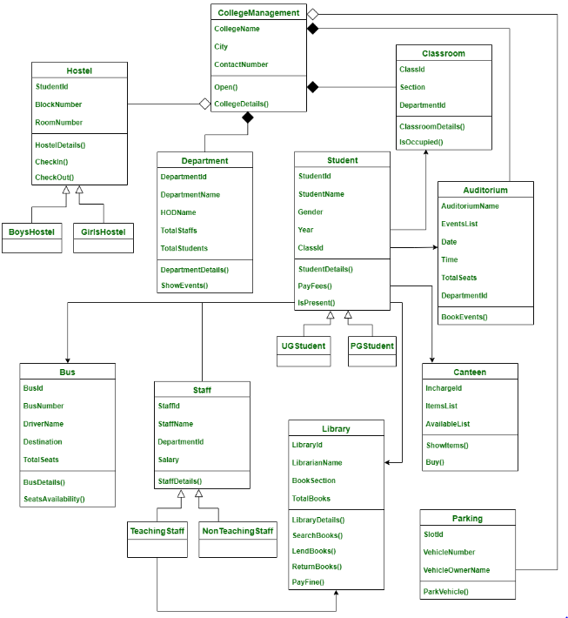
Class Diagram

Slide 21
Library Management System :
Classes of Library Management System :
Library Management System class – It manages all operations of Library Management System. It is central part of organization for which software is being designed.
User Class – It manages all operations of user.
Librarian Class – It manages all operations of Librarian.
Book Class –It manages all operations of books. It is basic building block of system.
Account Class –It manages all operations of account.
Library database Class –It manages all operations of library database.
Staff Class –It manages all operations of staff.
Student Class –It manages all operations of student.

Slide 22
Attributes of Library Management System :
Library Management System Attributes – UserType, Username, Password
User Attributes –Name, Id
Librarian Attributes –Name, Id, Password, SearchString
Book Attributes –Title, Author, ISBN, Publication
Account Attributes –no_borrowed_books, no_reserved_books, no_returned_books, no_lost_books fine_amount
Library database Attributes –List_of_books
Staff Class Attributes –Dept
Student Class Attributes –Class

Slide 23
Methods of Library Management System :
Library Management System Methods –Login(), Register(), Logout()
User Methods –Verify(), CheckAccount(), get_book_info()
Librarian Methods –Verify_librarian(), Search()
Book Methods –Show_duedt(), Reservation_status(), Feedback(), Book_request(), Renew_info()
Account Methods –Calculate_fine()
Library database Methods –Add(), Delete(), Update(), Display(), Search()

Slide 24
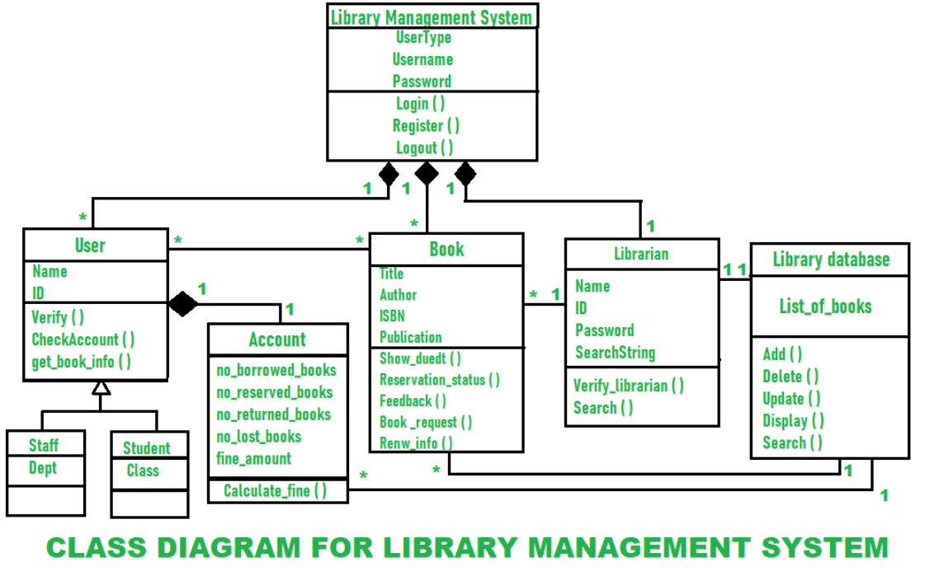
Class Diagram

Slide 25
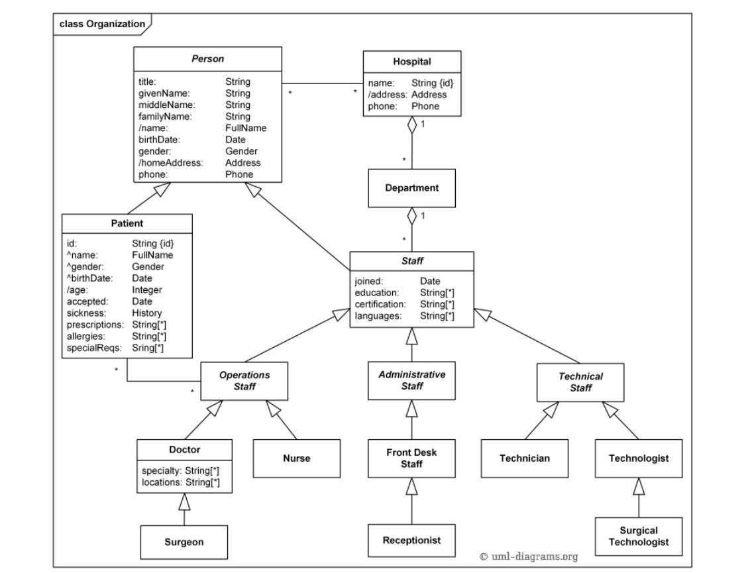
Hospital Management System

Slide 26
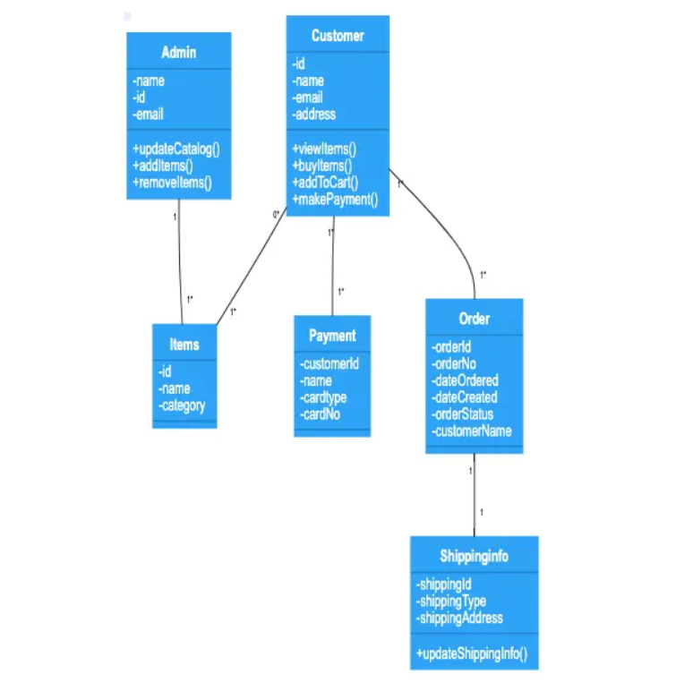
Online shopping system

Slide 27
Practice Questions
What is multiplicity or cardinality in class diagrams?
In UML diagrams, there are most often six types of relationships between classes. What are they?
What UML diagram types can be created?

Slide 28
Bibliography
https://www.gleek.io/blog/uml-diagram-types
https://www.gleek.io/blog/class-diagram-arrows
https://www.geeksforgeeks.org/class-diagram-for-library-management-system/
https://creately.com/diagram/example/gsxncbybs/hospital-management-system-class-diagram

